Slide 1




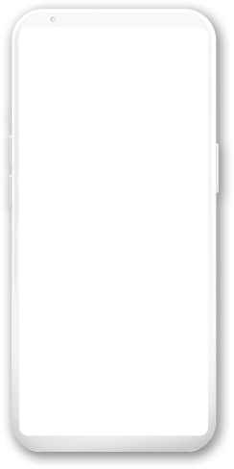



WhatsApp application

Slide 2






Introduction

Slide 3



Introduction to WhatsApp
WhatsApp is a popular mobile messaging application that was first launched in 2009. It is now owned by Facebook and has over 2 billion active users worldwide. WhatsApp allows users to send text messages, voice messages, make voice and video calls, as well as share images, videos, and documents with other users

Slide 4
Problem Solved by WhatsApp:
Before WhatsApp, traditional SMS messaging was the primary means of communication on mobile devices. SMS messages were limited to 160 characters, and users were charged per message sent. This made it expensive and impractical to have extended conversations via text message. With the rise of internet-enabled smartphones, WhatsApp was developed to provide a cost-effective alternative to SMS and bring the convenience of instant messaging to mobile devices.

Slide 5
Background
WhatsApp was founded by two former Yahoo employees, Brian Acton and Jan Koum. The company was initially started as a way to help people stay in touch with their families and friends, particularly those living in different countries. The app quickly gained popularity and was acquired by Facebook in 2014 for $19 billion.

Slide 6
Work Plan:
To develop a WhatsApp-like messaging application, several steps need to be followed. These include identifying the target audience and their needs, selecting the appropriate technology stack, designing the user interface, developing the core messaging functionality, and testing and debugging the application.

Slide 7


1
Requirements

Slide 8
example for Functional Requirements:
1.The user should be able to register for the application using their email or phone number.
2.The user should be able to create, edit, and delete contacts and groups for easier communication.
3.The user should be able to send and receive text messages, voice messages, images, videos, and documents.

Slide 9
example for Non Functional Requirements:
1.The application should be designed and optimized for high performance with minimal latency and downtime.
2.The application should have a mechanism to collect and analyze user feedback to improve the user experience.
3.The application should be designed to handle a large user base and be scalable as the user base grows.

Slide 10
2
Activity diagram

Slide 11
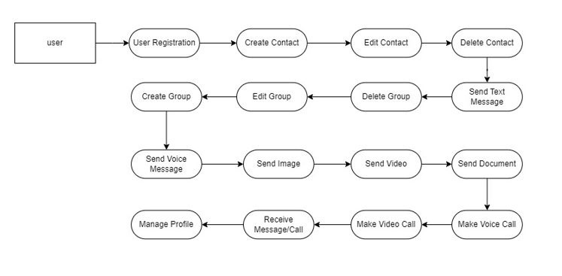
An activity model of the User

Slide 12
3
Use Cases

Slide 13
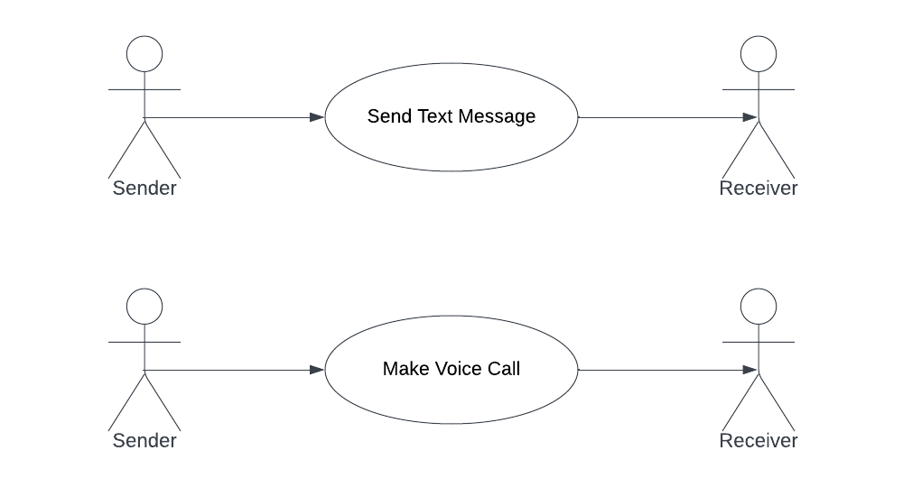
Send-Text-Message Use case:

Slide 14
Make-Voice-Call Use case:

Slide 15
4
Sequence Diagrams

Slide 16
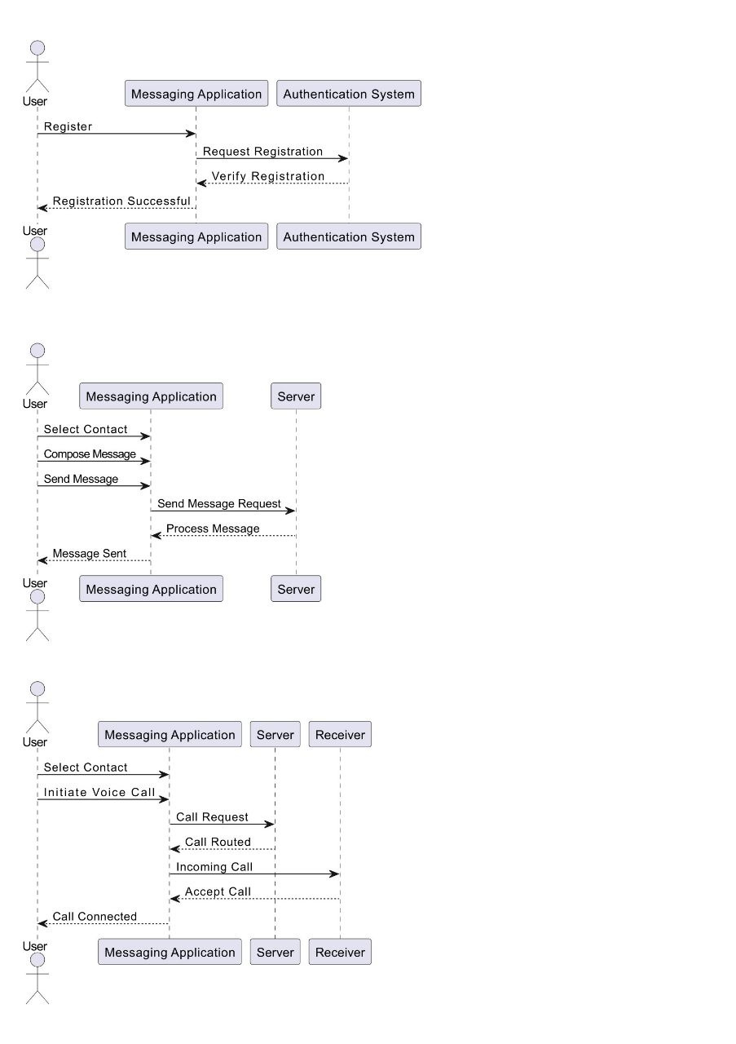
Sequence Diagrams

Slide 17
Sequence Diagrams

Slide 18
Sequence Diagrams

Slide 19
5
Class Diagrams

Slide 20
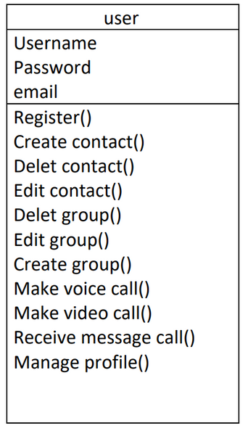
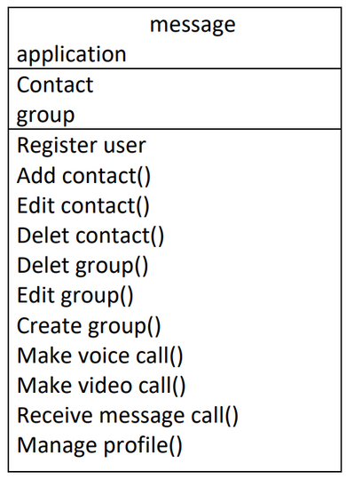
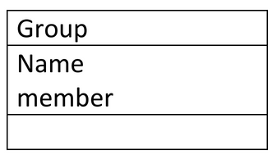
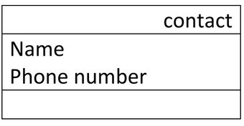
Classes and associations:
Class User:
Class Message app:
Class Group:
Class Contact:
Contact

Slide 21
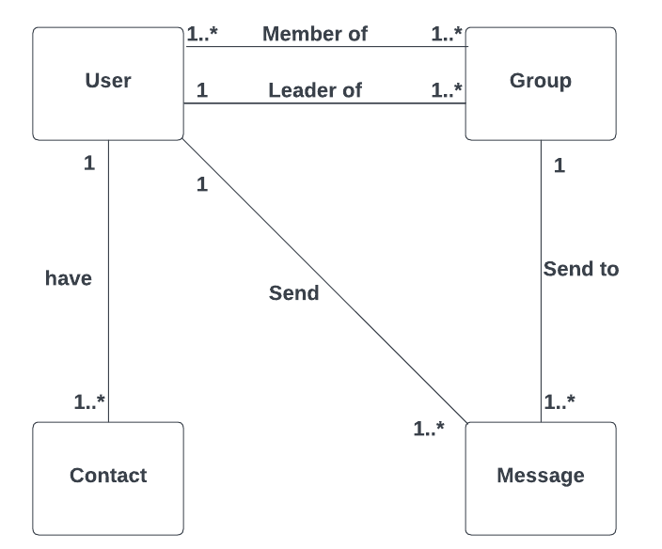
Classes and associations:

Slide 22


The End
Any Questions?

Slide 23


Team Members
Fahad
Omar
CS-Student
CS-Student

Slide 24


Thank you!

